Slide 1
The divide-and-conquer strategy

Slide 2
Floor and Ceiling Functions
The floor function, also called the greatest integer function or integer value gives the largest integer less than or equal to ⌊x⌋.
Ceiling function ⌈x⌉, gives the smallest integer ≥ x
For all real x, x-1 < ⌊x⌋ ≤ x ≤ ⌈x⌉ < x+1

Slide 3
Algorithmic Paradigms
Techniques for the Design of Algorithms:
  General approaches to the construction of efficient solutions to problems.
Such methods are of interest because:
  They provide templates suited to solving a broad range of diverse problems which can be precisely analyzed.
  They can be translated into common control and data structures provided by most high-level languages.
Subsequent lectures will examine paradigms, such as:
  Divide and Conquer
  Greedy
  Dynamic Programming
  Backtracking, branch and bound, ….
Although more than one technique may be applicable to a specific problem, it is often the case that an algorithm constructed by one approach is clearly superior to equivalent solutions built using alternative techniques.
  The choice of design paradigm is an important aspect of algorithm analysis

Slide 4
Divide-and-Conquer Strategy
Divide and Conquer is a general algorithm design paradigm that has created such efficient algorithms as Merge Sort, Binary Search, ….
This method has three distinct steps:
  Divide: If the input size is too large, divide the input into two or more sub-problems. That is, divide P P₁, …, P_{k}
    If the input size of the problem is small, it is solved directly
  Recur: Use divide and conquer to solve the sub-problems associated with each one-k^{th} of the data subsets separately, That is, find solution for S(P₁), …, S(P_{k})
  Conquer: Take the solutions to the sub-problems and combine (“merge”) these solutions into a solution for the original problem. That is, Merge S(P₁ ), …, S(P_{k}) S(P)

Slide 5
The Divide and Conquer Strategy
Implementation: suppose we consider the divide-and-conquer strategy when it splits the input into two sub-problems of the same kind as the original problem.
If the input size of the problem is small, it is solved directly.
If the input size of the problem is large, apply the strategy:
  Divide: divide the input data S in two disjoint subsets S₁and S₂
  Recur: Solve each half of the sub-problems associated with S₁ and S₂
  Conquer: combine the solution for S₁and S₂ into a solution for S

Slide 6
General Algorithm
procedure DCS (P)
if small(P) then
return S(P)
else
divide P into smaller instances P₁, P₂ …, P_{k}
apply DCS to each of these sub-problems
return (combine(DCS(P₁), DCS(P₂), …, DCS(P_{k}))
end if;
end DCS;
Complexity: f(n) n small
aT(n/b) + g(n) otherwise, where
b be the ways we divide the problem at each step
a be the number of sub-problems we solve at each step; i.e. n/b.
T(n) be the time needed to solve the problem with input of size n
g(n) be the time for dividing the problem and for combining solutions to sub-problems
f(n) be the time to compute the answer directly for small inputs
T(n) =

Slide 7
Divide-and-Conquer Technique
a problem of size n
(instance)
subproblem 1
of size n/2
subproblem 2
of size n/2
a solution to
subproblem 1
a solution to
subproblem 2
a solution to
the original problem
In general, it leads to a recursive algorithm with complexity
T(n) = 2 T(n/2) + g(n)

Slide 8
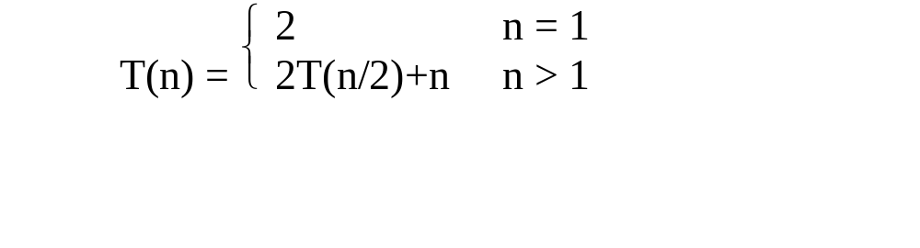
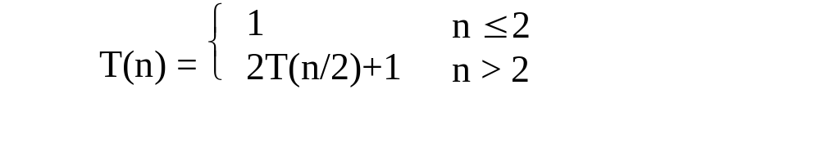
Solving Recurrence Relation
One of the method for solving recurrence relation is called the substitution method.
  This method repeatedly makes substitutions for each occurrence of the function T(n) until all such occurrences disappear
Example: Solve the following recurrence by substitution
  1.
  2.

Slide 9
Example of Recursion: SUM A[1…n]
Problem: Write a recursive function to find the sum of the first n integers A[1…n] and output the sum
  Example: given k = 3, we return sum = A[1] + A[2] + A[3]
  given k = n, we return A[1] + A[2] + … + A[n]
  How can you define the problem in terms of a smaller problem of the same type?
1 + 2 + … + n = [1 + 2 + … + (n -1)] + n
for n > 1, f(n) = f(n.1) + n
  How does each recursive call diminish the size of the problem? It reduces by 1 the number of values to be summed.
  What instance of the problem can serve as the base case?
  n = 1
  As the problem size diminishes, will you reach this base case? Yes, as long as n is nonnegative. Therefore, the statement “n >= 1” needs to be a precondition

Slide 10
Example of Recursion : SUM A[1…n]
Problem: Write a recursive function to find the sum of the first n integers A[1…n] and output the sum
algorithm LinearSum(A, n)
// Input: an array A with n elements
// Output: The sum of the first n integers in A
if n = 1 then
return A[0]
else
return LinearSum(A, n - 1) + A[n]
end algorithm
call
return
15
+
A
[
4
] =
15
+
5
=
20
LinearSum
(
A
,
5
)
call
return
13
+
A
[
3
] =
13
+
2
=
15
Example recursion trace:
LinearSum
(
A
,
4
)
call
return
7
+
A
[
2
] =
7
+
6
=
13
LinearSum
(
A
,
3
)
call
return
4
+
A
[
1
] =
4
+
3
=
7
LinearSum
(
A
,
2
)
call
return
A
[
0
] =
4
LinearSum
(
A
,
1
)

Slide 11
Binary Recursive Method
Binary recursion occurs whenever there are two recursive calls for each non-base case.
  Algorithm BinarySum(A, i, n):
  //Input: An array A and integers i and n
  //Output: The sum of the n integers in A starting at index i
  if n = 1 then
  return A[i ]
  return (BinarySum(A, i, n/ 2) + BinarySum(A, i + n/ 2, n/ 2))
end algorithm
0
,
8
0
,
4
4
,
4
0
,
2
2
,
2
4
,
2
6
,
2
0
,
1
1
,
1
2
,
1
3
,
1
4
,
1
5
,
1
6
,
1
7
,
1

Slide 12
Binary search
Binary Search is an algorithm to find an item in a sorted list.
  very efficient algorithm for searching in sorted array
  Limitations: must be a sorted array
Problem: determine whether a given element K is present in the given list or not
  Input: Let A = <a₁, a₂, … a_{n}> be a list of elements that are sorted in non-decreasing order.
  Output: If K is present output its position. Otherwise output “Not Found”.
Implementation:
  Pick the pivot item in the middle: Split the list in two halves (size n/2) at m so that
  A[1], … A[m], … A[n].
  If K = A[m], stop (successful search);
  Otherwise, until the list has shrunk to size 1 narrow our search recursively to either
  the top half of the list : A[1..m-1] if K < A[m] or
  the bottom half of the list: A[m+1..n] if K > A[m]

Slide 13

Example
Example: Binary Search for 64 in the given list A[] = {5 8 9 13 22 30 34 37 41 60 63 65 82 87 90 91}
  Looking for 64 in this list.
  Divide the list into two (1+17)/2 = 9
  Pivot = 38. Is 64 < 38? No.
  Recurse looking for 64 in the list > 38.
  etc.
Pivot
Given 14 elements: A[1:14] = (-15, -6, 0, 7, 9, 23, 54, 82, 101, 112, 125, 131, 142, 151).
  Construct binary search tree and search for (i) 151, (ii) 10

Slide 14
Binary Search Recursive Algorithm
Four Questions in designing recursive algorithm
How can you define the problem in terms of a smaller problem of the same type?
Look at the middle of the list. Then recursively search the top or bottom half, as appropriate.
How does each recursive call diminish the size of the problem?
It cuts the size of the list in half (roughly).
What instance of the problem can serve as the base case?
base case = 1.
As the problem size diminishes, will you reach this base case?
Yes, A list cannot have negative size.

Slide 15
Binary Search Recursive Algorithm
procedure BSearch(A, low, high, key)
// A is sorted array. Low =1, high = n
if low = high then
if key = A[low] then return low
else return “Not Found”;
end if
else
mid = (low + high)/2;
if key > A[mid]
return BSearch(A, mid+1, high, key);
else
return BSearch(A, low, mid-1, key);
end if
end if
end algorithm

Slide 16
Binary Search Iterative Algorithm
Procedure BinarySearch(A, n, key)
low ← 1; high ← n;
while low ≤ high do
mid ← ⎣(low+high)/2⎦
if key = A[mid] then
return mid
else if key < A[mid] then
high ← mid-1
else low ← mid+1
return “NotFound”
end

Slide 17
Binary Search Iterative Algorithm
Analysis: considering the number of element comparison, the worst-case recurrence is:
  T(n) = 1 n =1
  T(n/2) + 1 n >1
T(n) = O(log2n). Show?

Slide 18
Finding the minimum & maximum
Let there are n elements < a₁, a₂, … a_{n}>. The problem is to find max and min elements in a set.
Straightforward algorithm
procedure max_min(A, n, max,min)
max = min = A[1]
for i = 2 to n do
if A[i] > max then
max = A[i]
if A[i] < min then
min = A[i]
end procedure
Can you suggest any improvement in the max_min algorithm ?
Analysis: there are 2(n-1) number of element comparisons in the best, worst and average cases.

Slide 19
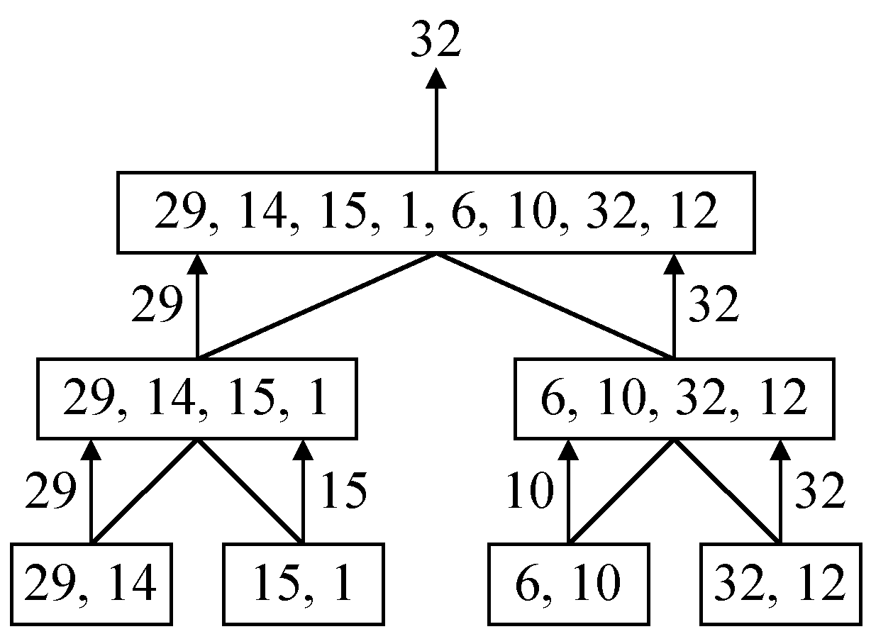
Divide and conquer for finding min & max
Recurrence relation:
If n =1, both max and min are the same.
max = min = a[1]
If n =2 the problem can be solved by making one element comparison
a[1] > a[2] or a[1] < a[2]
If n > 2 divide < a₁, a₂, … a_{n}> into two instances a[1..n/2] and a[n/2+1…n] and solve the sub-problems recursively.
Example: find the maximum of a given set of n numbers a[] = {29 14 15 1 6 10 32 12}

Slide 20
Recursive algorithm
procedure max_min(A, low, high, max, min)
if low = high then
max = min = A[1]
  else if low = high – 1 then
  if A[low] < A[high] then
  max = A[high]; min = A[low]
  else
  max = A[low]; min = A[high];
  end if
  else
  mid = ⎣(low+high)/2⎦
max_min(A, low, mid, max, min);
max_min(A, mid+1, high, max2, min2);
if max < max2 then max = max2;
if min > min2 then min = min2;
end if
end procedure

Slide 21
Exercise
Consider the searching problem.
Given a sequence of n numbers, A = <a₁, a₂, …, a_{n}> and a value Key, write a code for linear search, which scans through the sequence, looking for Key, and returns one or more position i such that Key = A[i].

